Slide 1
T2I-Adapter: Learning Adapters to Dig Out More Controllable Ability for Text-to-Image Diffusion Models
C. Mou, X. Wang, L. Xie, Y. Wu, Z. Qi, Y. Shan, and X. Qie, “T2I-Adapter: Learning adapters to dig out more controllable ability for text-to-image diffusion models,” in Proc. 38th AAAI Conf. Artif. Intell. (AAAI), 2024. Available: https://arxiv.org/abs/2302.08453
2025-04-03
Sein Choi
Intelligent Vision Processing Lab. (IVPL)
https://ivpl.sookmyung.ac.kr
Div. of AI Engineering, Sookmyung Women’s University
E-mail: csi1806@sookmyung.ac.kr

Slide 2
T2I
No. | Title | Keyword | Cite
1 | High-Resolution Image Synthesis with Latent Diffusion Models | Text-to-Image Generation, VAE, Diffusion Models, Cross-Attention | Rombach, R., Blattmann, A., Lorenz, D., Esser, P., & Ommer, B.,"High-Resolution Image Synthesis with Latent Diffusion Models," in Proc. the IEEE/CVF Conference on Computer Vision and Pattern Recognition (CVPR), 2022. Available: https://arxiv.org/abs/2112.10752
2 | SDXL: Improving Latent Diffusion Models for High-Resolution Image Synthesis | LDM | D. Podell, Z. English, K. Lacey, A. Blattmann, T. Dockhorn, J. Müller, J. Penna, and R. Rombach, "SDXL: Improving Latent Diffusion Models for High-Resolution Image Synthesis,“, in Proc. the IEEE/CVF Conference on Computer Vision and Pattern Recognition (CVPR), 2023. Available: https://arxiv.org/abs/2307.01952.
3 | Adding Conditional Control to Text-to-Image Diffusion Models | LDM, zero convolution, trainable copy, Image Conditioning | Lvmin Zhang, Anyi Rao, Maneesh Agrawala, “Adding Conditional Control to Text-to-Image Diffusion Models”, in Proc. the IEEE/CVF Conference on Computer Vision and Pattern Recognition (CVPR), 2024. Available: https://arxiv.org/abs/2302.05543
4 | T2I-Adapter: Learning Adapters to Dig Out More Controllable Ability for Text-to-Image Diffusion Models | LDM, Image Conditioning | C. Mou, X. Wang, L. Xie, Y. Wu, Z. Qi, Y. Shan, and X. Qie, “T2I-Adapter: Learning adapters to dig out more controllable ability for text-to-image diffusion models,” in Proc. 38th AAAI Conf. Artif. Intell. (AAAI), 2024. Available: https://arxiv.org/abs/2302.08453
5
6

Slide 3
Contents
Introduction
T2I-Adpater
Ablation Study
Model Optimization
Training & Experiment
Conclusion & Limitation
Sampling

Slide 4
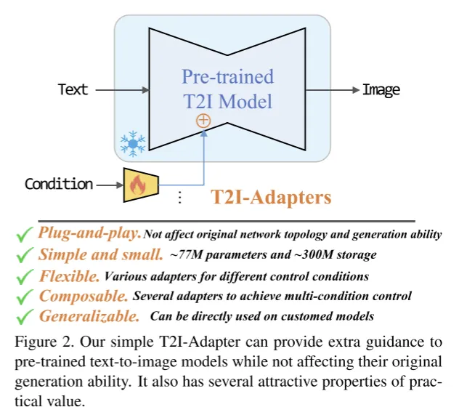
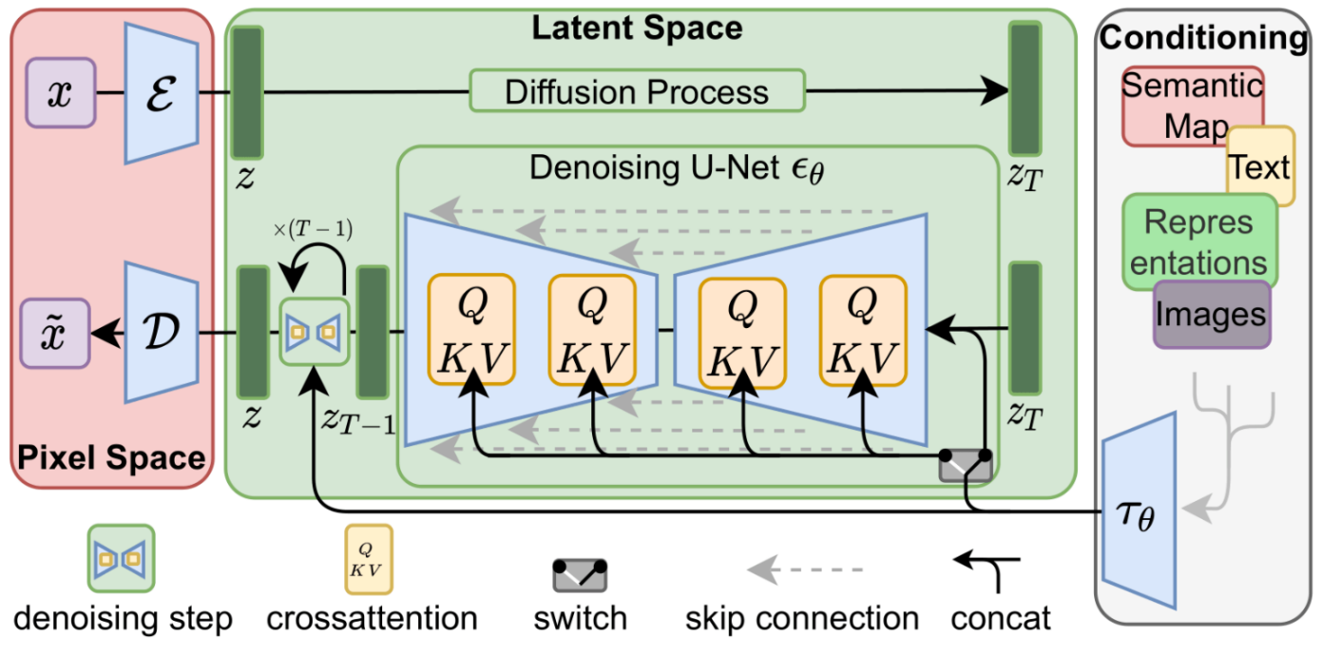
Introduction
Text cannot provide accurate guidance
Issues with text prompts - They do not provide accurate generation guidance that can fully align the internal knowledge of SD with external control.
Solve “alignment” issue – T2I internal knowledge & external control signal

Slide 5
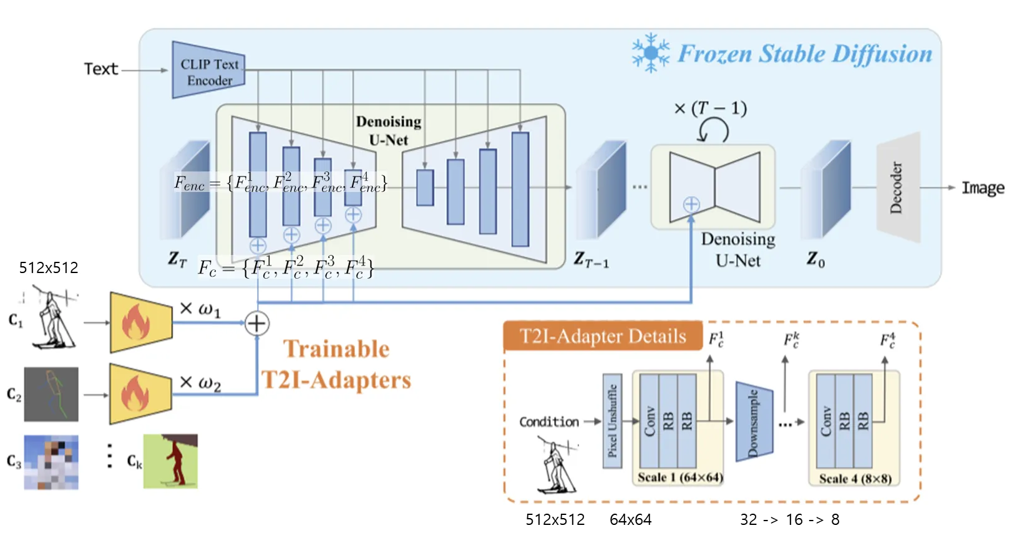
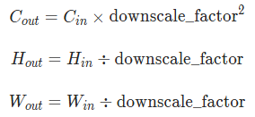
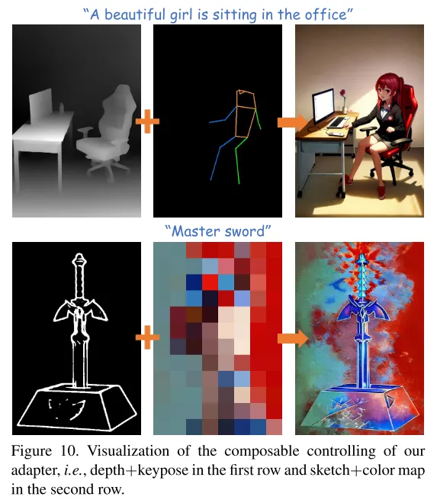
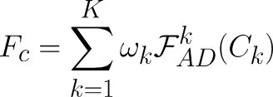
T2I-Adapter
pre-trained SD model (frozen) + several T2I-Adapters (activate)
cf. Pixel Unshuffle

Slide 6
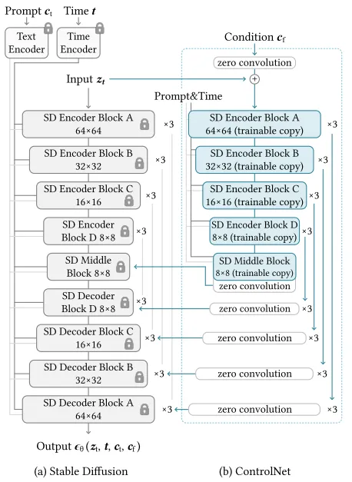
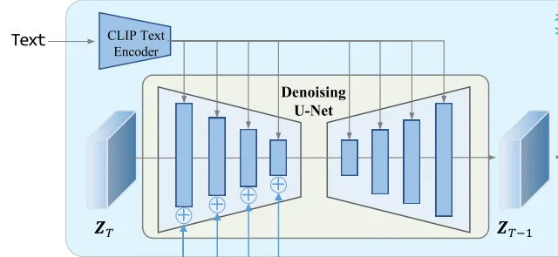
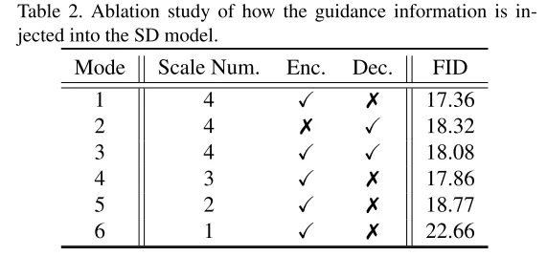
Ablation Study
cf. ControlNet Structure
Guidance Mode
(4 ResNet + 2 ViTs)

Slide 7
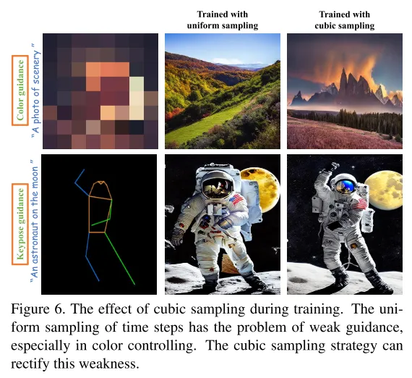
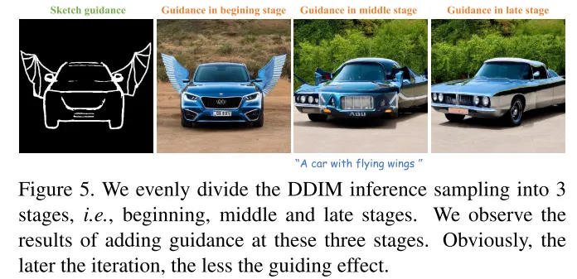
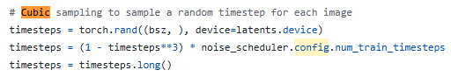
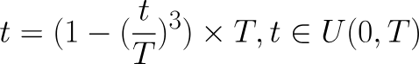
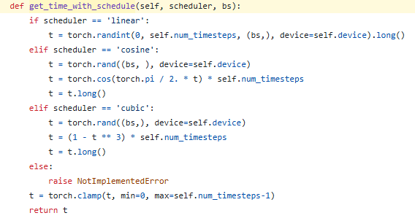
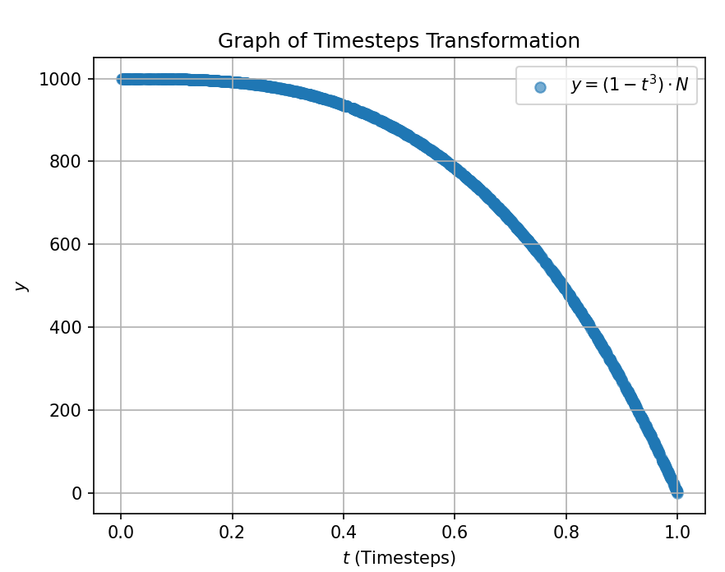
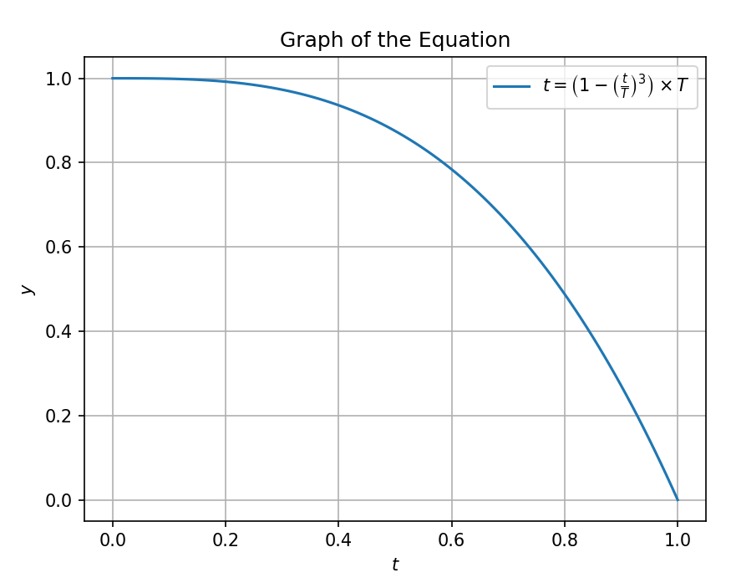
Model Optimization
Optimization function
Cubic function
cf. ControlNet function
https://github.com/TencentARC/T2I-Adapter/blob/main/train_sketch.py
https://github.com/TencentARC/T2I-Adapter/blob/7056c7fb080afc55ce246b2e8b5d0488977fc72f/ldm/models/diffusion/ddpm.py#L808
T2I-Adapter/ldm/models/diffusion/ddpm.py

Slide 8
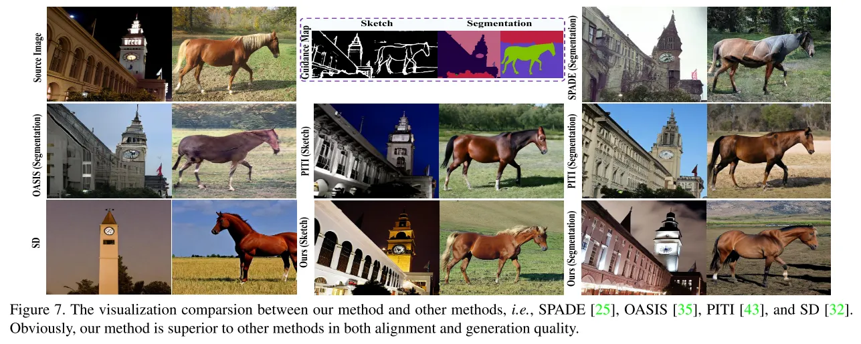
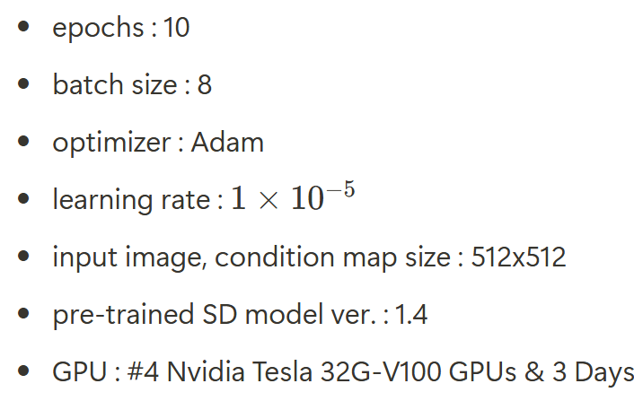
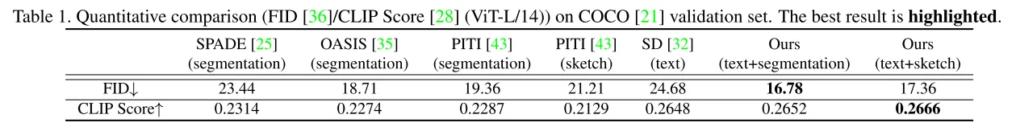
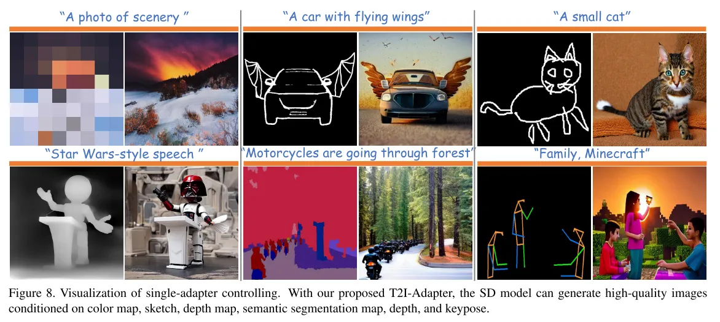
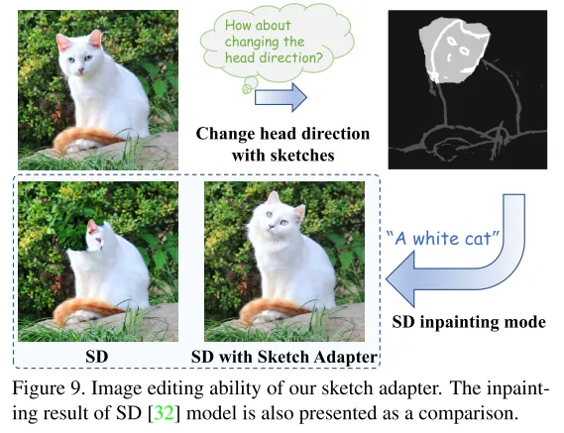
Training & Experiment
Training details

Slide 9
Conclusion & Limitation
Conclusion
Simple and lightweight design
Easily attached in a modular format
Various multi-adapter guidance are possible
Available image editing
Limitation
Multi-adapter guidance must be done manually

Slide 10
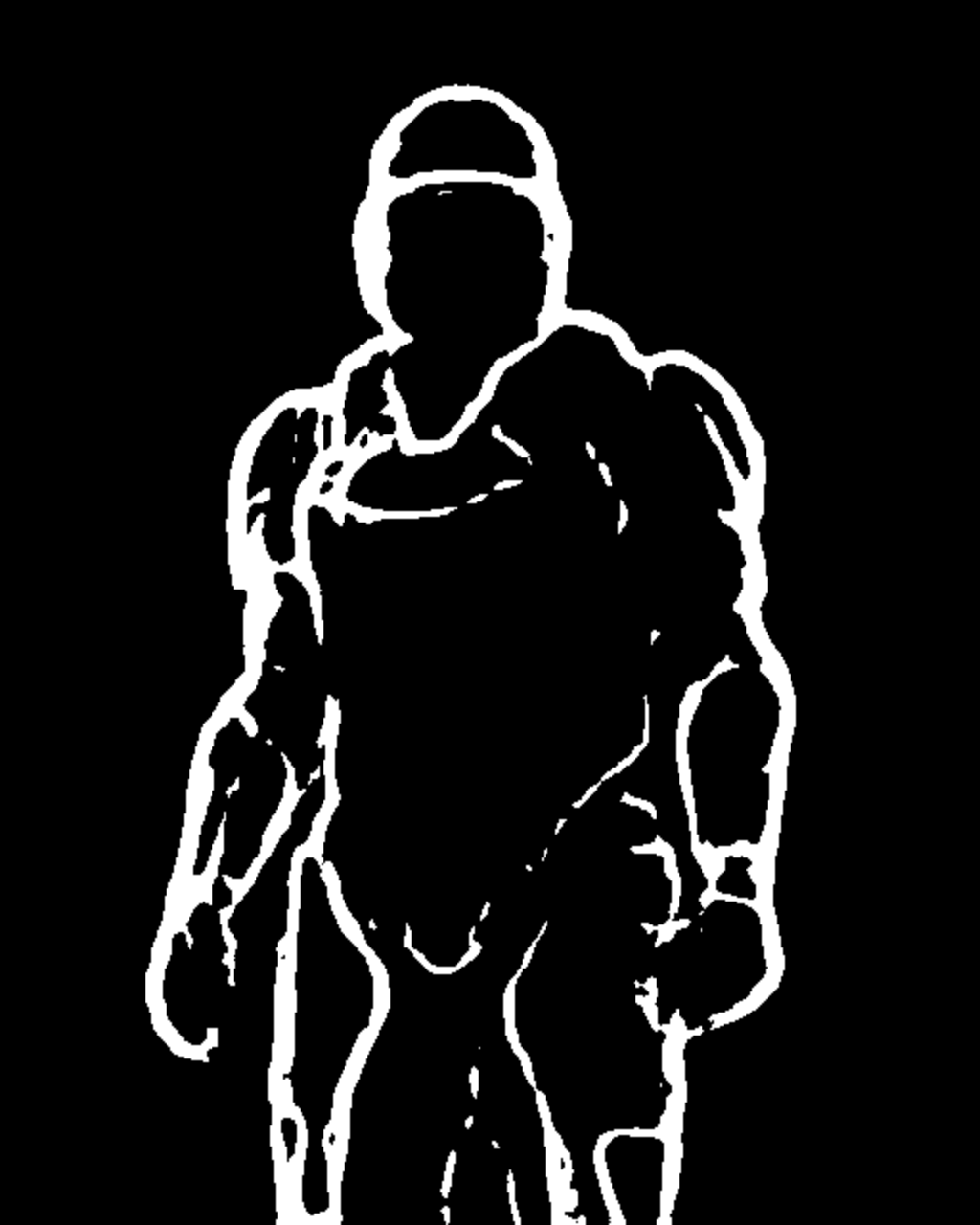
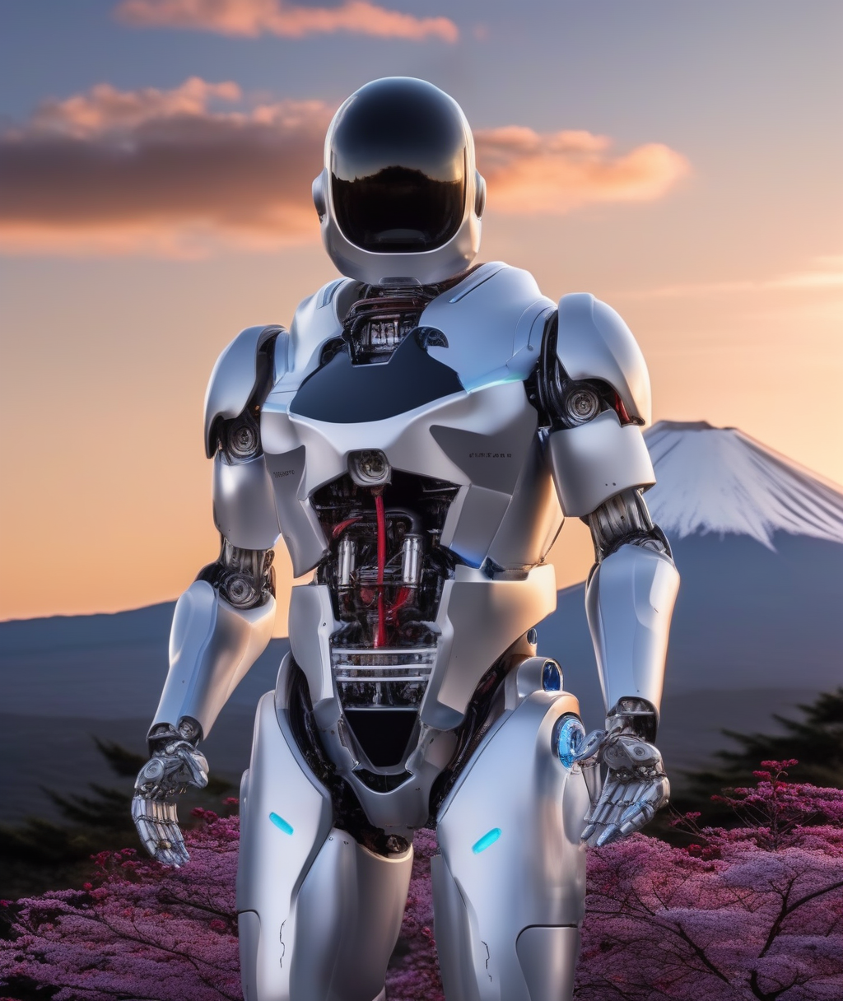
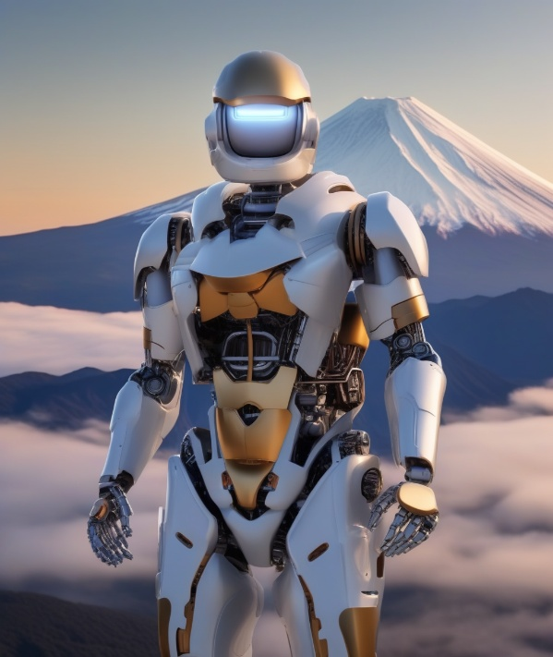
Sampling
Sketch conditioning
prompt = "a robot, mount fuji in the background, 4k photo, highly detailed"
negative_prompt = "extra digit, fewer digits, cropped, worst quality, low quality, glitch, deformed, mutated, ugly, disfigured“
sampling resolution : 1024*1024
GPU memory usage : 9.7G
Sampling time : 3min (30 inference step)
sampling output
example

Slide 11
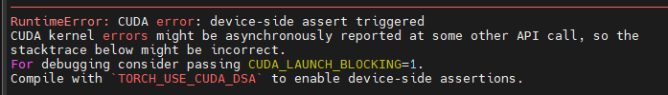
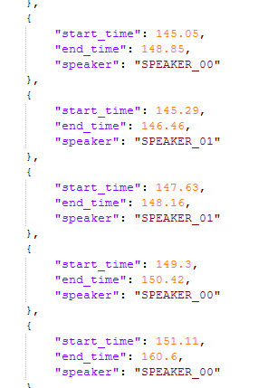

Slide 12
Thank you for your attention.!!!
QnA

